Slide 1
Notes to presenter
Please delete this slide before presenting to your students.
This resource contains 7 slides and should take around 15 – 20 minutes to deliver to students.
There is a link to the ‘Apprentices are Amazing’ film included and you may find it useful to download this in advance of delivering the session.
Please do make any appropriate edits for instructions or to include bespoke messaging from your school/college.
Each slide has an accompanying script in the notes section. This script is for guidance and can be adapted to suit the needs and interests of your students.
This slide deck forms part of a wider selection of resources available to schools/colleges participating in the ‘Try a Trade’ programme. If you have any questions or problems, please contact Hello@AmazingApprenticeships.com

Slide 2
Apprenticeships in domestic trades
© Vetted Limited all rights reserved
Notes:
Presenter: There are many options available to you on completing year 11/12/13.
Staying in full time education - for example at school, sixth form college, further education college or University Technical College
You could start an apprenticeship
Or you could move into work or volunteering, whilst also doing part-time education or training
Today’s presentation is going to explore apprenticeships and help you to understand the wide range of options available in the domestic trades sector that are available for you to consider.

Slide 3
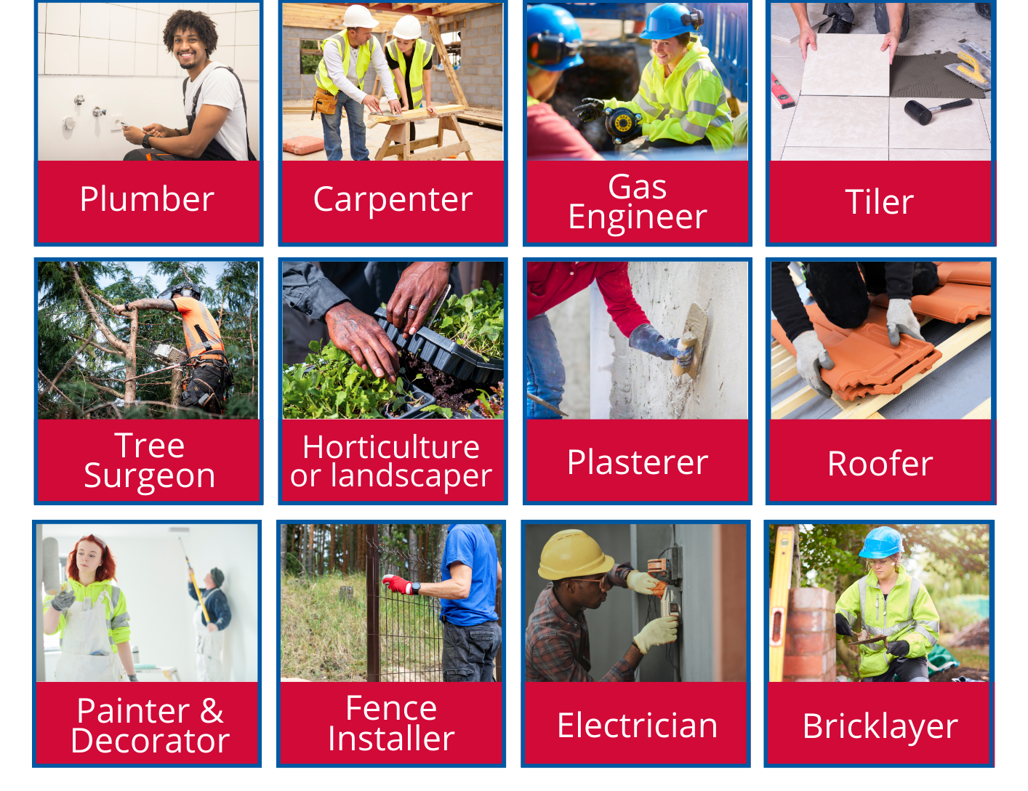
Apprenticeships in domestic trades
© Vetted Limited all rights reserved
Notes:
Presenter: I’m going to start by asking you a question:
Question: What do all of these occupations have in common?
Answer: They are all considered to be ‘domestic trades’
Through the Try a Trade programme, Checkatrade is supporting students to explore 12 different and exciting career options in domestic trades.
There are a lot of misconceptions about domestic trades out there. Some people might think that they are only in low-skilled jobs, or that they are not very well paid – but that is not true.
Each of the 12 trades shown on this screen can be studied through an apprenticeship and once qualified, the earning potential is huge.
Once you’ve got qualified and have got the experience, you could even set up your own business – and maybe even employ your own apprentices!
For today, we’re going to focus on helping you to understand what apprenticeships are, and how you can start to do your own research to find out more.

Slide 4
Apprentices are amazing
© Vetted Limited all rights reserved
Notes:
Note to presenter: Please download the film from Vimeo and embed it within this presentation. The film is available to download here: https://vimeo.com/613415806
Presenter: Before we explore domestic trades in more detail, we’re going to take some time to discuss apprenticeships and find out more about what an apprenticeship is.
I’m going to play you this short film which gives an insight into what apprenticeships are available and what it’s like to be an apprentice, and then we’ll move on to discussing some of the detail behind how apprenticeships work.
So let’s take a look at the film to hear from some real apprentices. You might be surprised at some of the job roles!
Notes to presenter: Click to play the film.

Slide 5
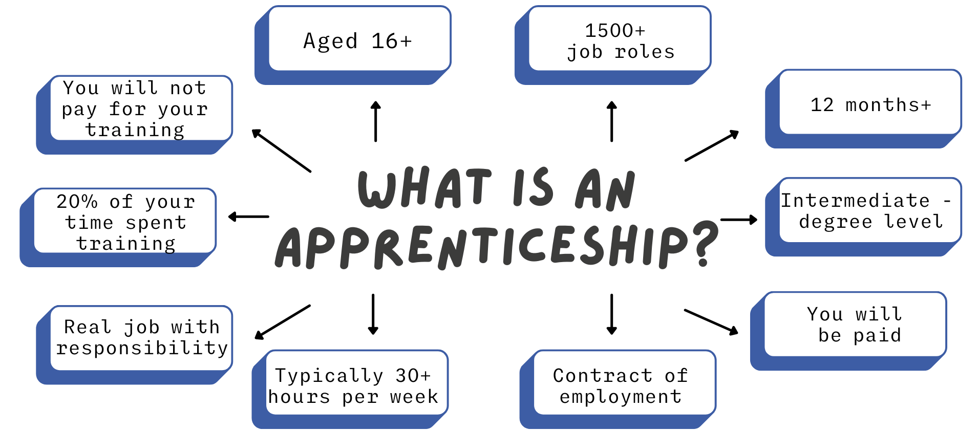
© Vetted Limited all rights reserved
Notes:
So what is an apprenticeship?
You may already know a bit about apprenticeships, but let’s run through some facts so that everyone understands the basics.
Apprenticeships are available in more than 1500 different job roles and as we’ve just seen – can cover everything from accountancy to zoo keeping!
They last for a minimum of 12 months and can last up to 6 years, depending on the level that you are studying at and the job role you are in.
There are many different levels of apprenticeship from intermediate level (which is sometimes called level 2) all the way through to degree level apprenticeships.
An apprenticeship can start at any level but some may require previous qualifications such as English or maths GCSEs or you may be given additional training in English or maths to make sure you are at the right level.
You will be employed as an apprentice, which means you will be paid a salary and will have a contract of employment. (The current national minimum wage for an apprentice is £5.28)
Apprentices usually work for a minimum of 30 hours per week, but it’s more likely you will be working full time which is usually 37.5 hours per week
You will have a real job, with real responsibility and your employer will work with you to develop your skills
The equivalent of 6 hours per week will be spent undertaking training.
You will not pay for your training costs, even if it’s a degree apprenticeship.
You can start an apprenticeship after you have completed year 11 – and this could be any time from the July onwards.

Slide 6
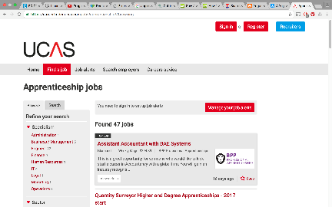
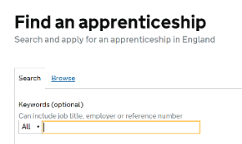
How do you find an apprenticeship?
1
3
Register on Find an apprenticeship
Search and apply
2
4
Do your research
Manage your alerts
© Vetted Limited all rights reserved
Notes:
Through the Try a Trade programme, we’re going to be getting into more detail around the application process for apprenticeships.
But if you’re keen to get started, then a great place to start is the Find An Apprenticeship service on gov.uk (the government website). Go to google and type in Find An Apprenticeship and the link will come up.
You can register an account for free, and then start searching (and even applying) for jobs that you might be interested in.
Click on ‘Manage your alerts’ and then you can set it up to send emails and text messages to you when jobs come up that you might be interested in.
We will be covering this in more detail in future sessions though.

Slide 7
How do you find an apprenticeship?
© Vetted Limited all rights reserved
Notes:
Through Try a Trade, we’ll also be supporting you to sign up to a jobs board where you can find construction apprenticeships and vacancies.
You will learn more about this in later sessions.

Slide 8
Find out more
© Vetted Limited all rights reserved
Notes:
The Try a Trade programme that our school is involved with, will help you to explore apprenticeships in more detail.
Through our lessons and activities, we will be looking into apprenticeships in more detail, meeting real apprentices, hearing from employers and also later in the summer, we will be able to help to match you up to local vacancies.

Slide 9
© Vetted Limited all rights reserved
Notes:
Thank you very much for listening today.
Are there any questions?

